Slide 1

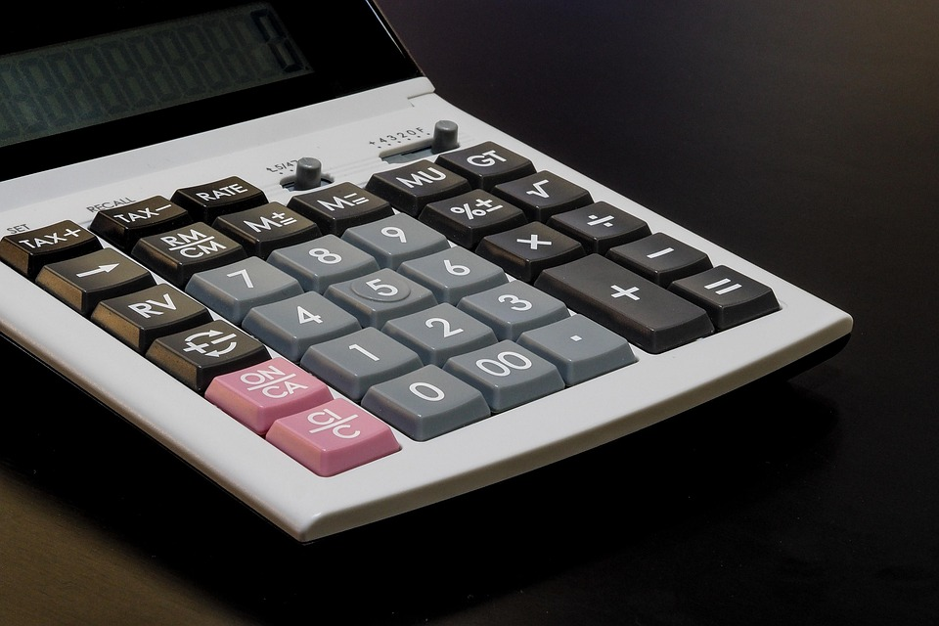
Scientific Web Calculator
TR-102
Ayush Mehta
(2302489)
HTML | CSS | Javascript | mathjs

Slide 2

Problem, Motivation & Objectives
Problem: native calculator features inconsistent behaviour and some web calculators use unsafe eval().
Motivation: safe, predictable scientific computation plus degree-based trig (user-friendly for many students).
Objectives:
Secure expression evaluation using mathjs and sandboxed scope.
Degree-mode sin, cos, tan with proper error handling.
UI: responsive, clear, scientific functions in separate pane.
Robust input handling: parentheses validation, max input length, consecutive operator prevention.

Slide 3
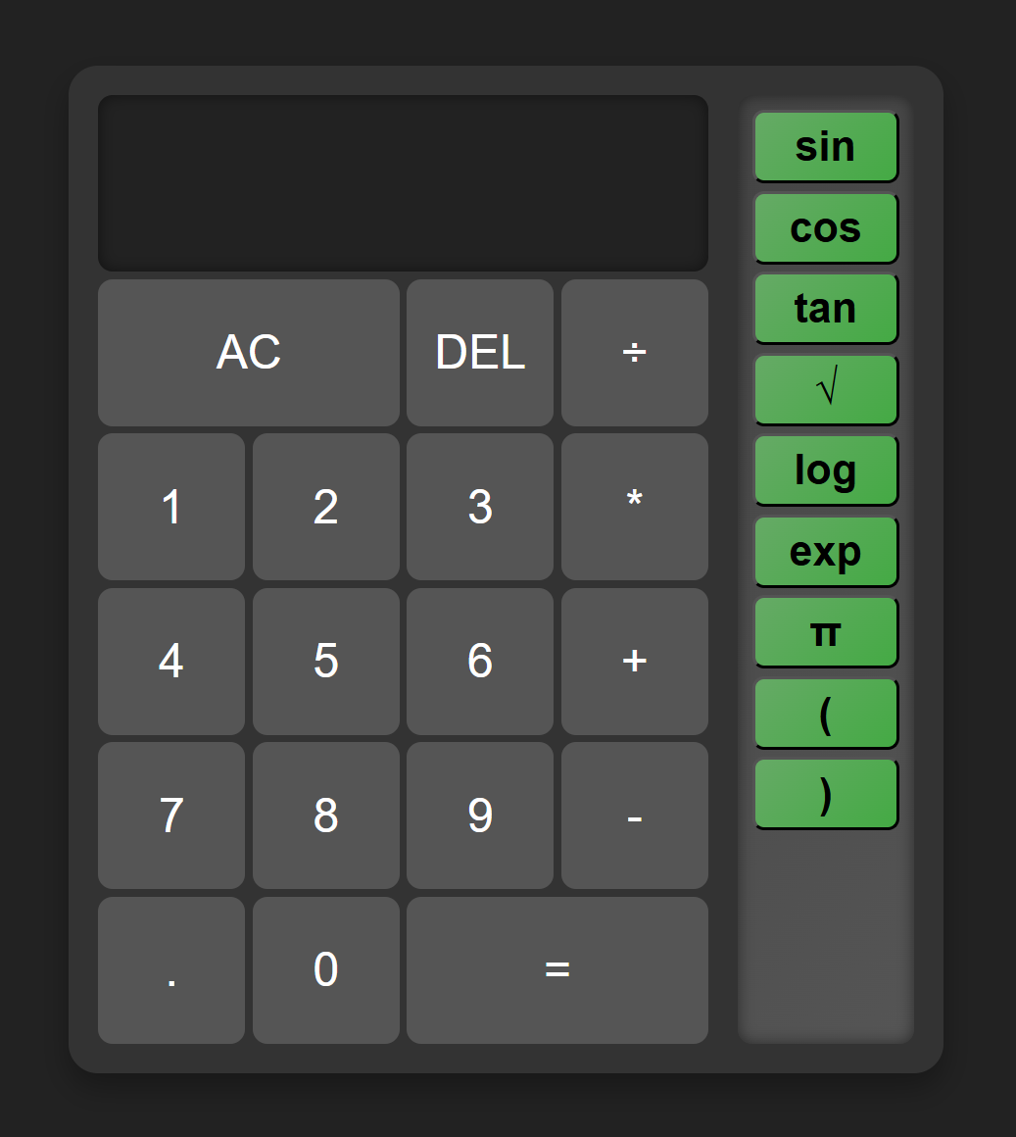
UI Walkthrough
Main Features:
Number pad, operations (+ − × ÷), decimal, delete, AC, equals.
Scientific functions: sin(), cos(), tan(), √, log (base10), exp, π, parentheses.
Keyboard support: numbers, operations, Enter = compute, Backspace = delete, Esc = clear.
Responsive display with clamp() font resizing.

Slide 4
Architecture & Core Implementation
User Input
Calculator . Appendix()
Display Update
Compute()
Pre Process
Math . Evaluate()
Result
Display
Custom trig (deg):
function sinDeg(x) {
if (typeof x !== 'number' || isNaN(x)) throw new Error('Invalid input for sin');
return Math.sin(x * Math.PI / 180);
}
Safe sqrt
function sqrtSafe(x) {
if (typeof x !== 'number' || isNaN(x)) throw new Error('Invalid input for sqrt');
if (x < 0) throw new Error('Square root of negative number');
return Math.sqrt(x);
}

Slide 5
Demo Plan, Test cases & Edge cases
Demo Steps:
Open index.html in browser (or serve via localhost).
Show basic calculation: 12 + 45 * 2 → press =.
Show scientific: click sin then type 30 then ) then = → expect 0.5.
Use π: π * 2 → =.
Parenthesis: (2+3) * 4.
Error demo: sqrt(-1) → shows error Square root of negative number.
Malformed input: ++ or 2*/3 → shows Invalid: consecutive operators or Empty expression/error message.
Keyboard usage: press keys to show keyboard support.
Tests and Edge Cases:
Balanced parentheses test: ((2+3)*4 → should display “Unbalanced parentheses”.
Tan at 90°: tan(90) → throws tan undefined at 90° or 270°.
Very long input: paste 200 chars → should get Input too long.
Non-numeric function args: sin(x) where x not defined → sanitization removes invalid chars; mathjs error handled.
Division by zero: 1/0 → mathjs result Infinity → treated as invalid → display error.
Injection attempts: sin; alert(1) — sanitized by regex in preprocess; demonstrate injection mitigation.

Slide 6
Results & Conclusion
Results: i. Stable UI with responsive display ii. Degree-mode trig validated (sin(30)=0.5) iii. Safe evaluation — no eval usage; sandboxed scope iv. Error handling for invalid inputs
Conclusion: This project demonstrates a secure, user-friendly scientific calculator with clear UX and robust input handling; suitable for educational use and quick computations.

